Slide 1
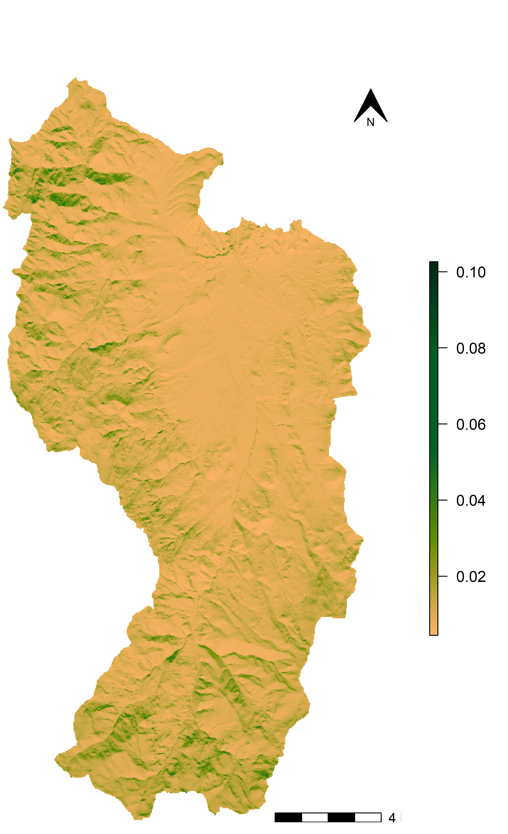
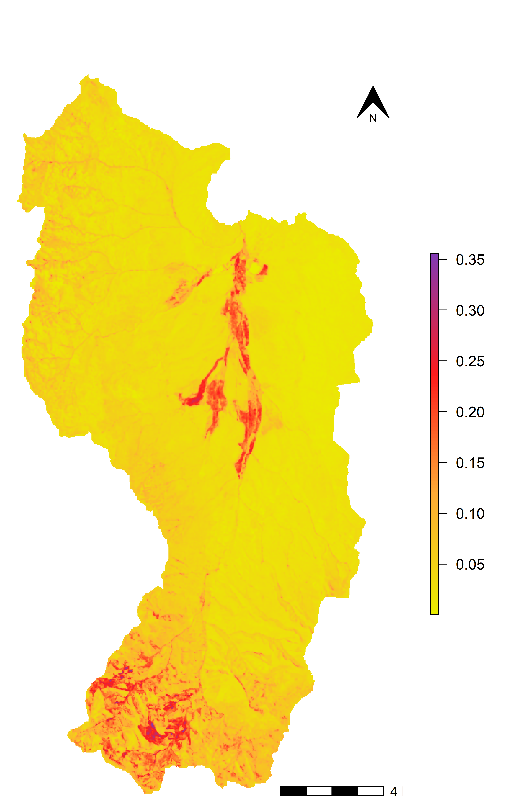
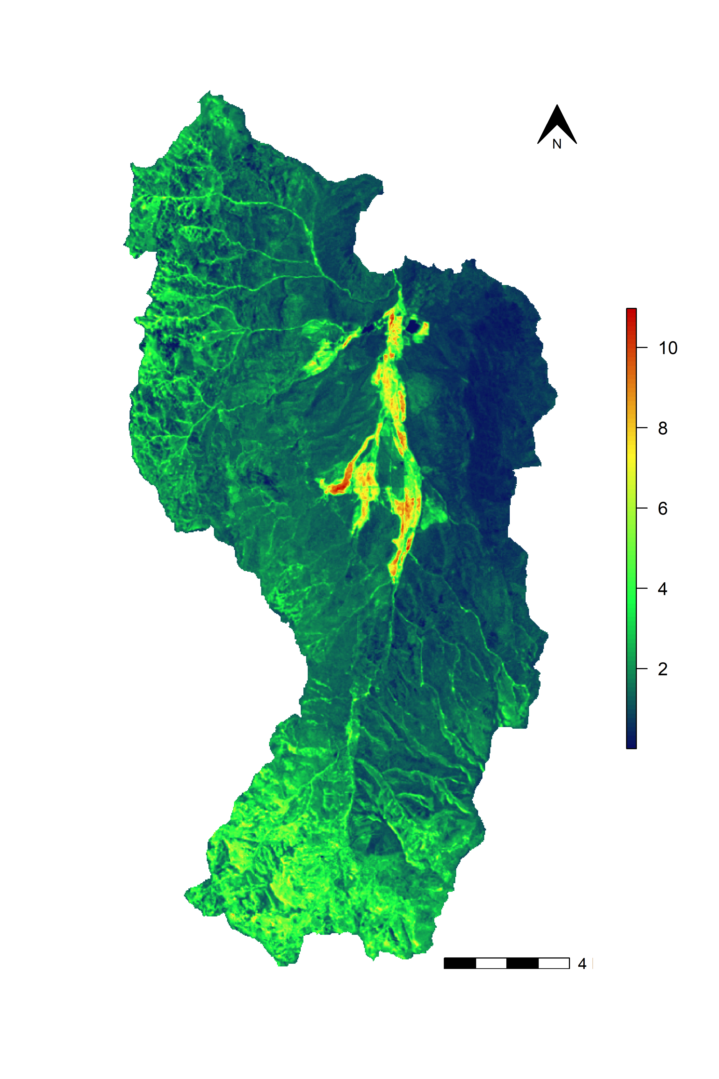
Litter C Pool
Microbial C Pool
Protected SOC Pool
kg C ^{m-2}
kg C ^{m-2}
kg C ^{m-2}
4 km

